Slide 1
Yacc & Lex
Or alternatively, Bison and Flex

Slide 2
So you want to build your own language….
You’ll need a compiler or interpreter if it’s a high level (anything above assembly) language!
It’ll probably need to be easily parsed
Should have reserved words
If, while, for… or something like that
Regular grammar
The language follows a CFG, basically
Probably needs one symbol lookahead
If shouldn’t just be If, it should be If something.

Slide 3
Build a Compiler!
A compiler allows you to turn a language into machine code.
It needs:
Symbol table (what do variables mean? Procedures?)
Parser
Syntax analysis – Probably should be simple
Code generation – You know, into machine code
Optimiser
Activation records – Not for itself, it needs to be able to build them.

Slide 4
Or, Build an Interpreter!
Interpreters interpret code into machine code at runtime.
PL0 is a language that used it
Has a syntax checker, parser, compiler & interpreter!
Uses a symbol table in interpreter
Not optimised
Uses interpreted activation records stored in ram dynamically.

Slide 5
Could you imagine doing this by hand?
Not exactly efficient.
Extremely complicated, especially writing the machine code compilation system
Have to keep a handle on all the activation records
Need to invent your own way of doing function context switching…
Not fun

Slide 6
Yacc and Lex, the Better Way.
Yacc: Yet Another Compiler Compiler
Unix compiler compiler.
Converts user grammar using C into grammar parser
Lex: Short for Lexical Analyser
Unix regular expression string matcher generator.
Converts a series of rules into a lexer program in C.
These are basically dead now because Unix is old.
We use the Linux versions. GNU Bison and BSD Flex (short for “Fast Lex”)

Slide 7
Lex
The Lexical Analyser

Slide 8
What is Lex?
Problem oriented specification for string matching.
You give it a specification, and it produces a language that recognises only regular expressions
This can do a lot of cool stuff, but can’t be a compiler on it’s own (you need Yacc for that)
Each matched string invokes some user code (all in C, so I hope you like C)
Always chooses the longest match
Might need way more than one character look ahead.

Slide 9
Basic Lex Example
Lex programs by convention are stored in .l files.
To compile Lex code, firt you need to use lex or flex lex somekindaprog.l
Then you use the GCC compiler (or your nearest non GNU equivalent) to produce the binary gcc –o something lex.yy.c –lfl OR, if using lex and not flex gcc –o something lex.yy.c –ll
To run, ./something < input.txt > output.txt
Input – abcdefh
Rules – ab
>abcdefh
>>Lex will find “ab”, and start matching again from “c”… and then it won’t find anything else.

Slide 10
More Lex Info
Lex.yy.c contains a subprogram yylex()
By default:
Lex uses a default main()
Reads from stdin
Writes to stdout
You can call yylex from your own code!
Automatically incorporates itself into yacc code
Has other functions too, yywrap for example handles multiple files.
However, most distributions of linux do not provide all definitions (eg yywrap and yyerror), so you may have to find them yourself on the web.

Slide 11
Lex Examples
Replaces all blanks and tabs at the end of each line.
%%
[\t ]+$ ;

Slide 12
Lex Examples
Replaces multiple blanks by single blank.
Also removes end of line spaces.
Scans for both rules at same time
Technically the eol statement is longer than just the spaces, so it has priority.
%%
[\t ]+$ ;
[\t ]+ printf(“ “);

Slide 13
Lex Examples
Searches for word “integer”
Prints “found INT”
%%
integer printf(“found INT”);

Slide 14
Lex Format
Lex generates a deterministic finite automaton from the regular expressions in it’s source
The full format for a file is over there →
The minimal lex program is just “%%”, which copies input to output.
{definitions} //optional
%%
{rules} //optional
%% //optional
{subroutines} //optional

Slide 15
Lex Regexes
Lex uses regular expressions to define all rules
These are almost exactly the same as the ones used in Unix
This shouldn’t be surprising, Lex was built for Unix.
Lex uses the following operators:
“ \ [ ] ^ - ? . * + | ( ) $ / { } % < >

Slide 16
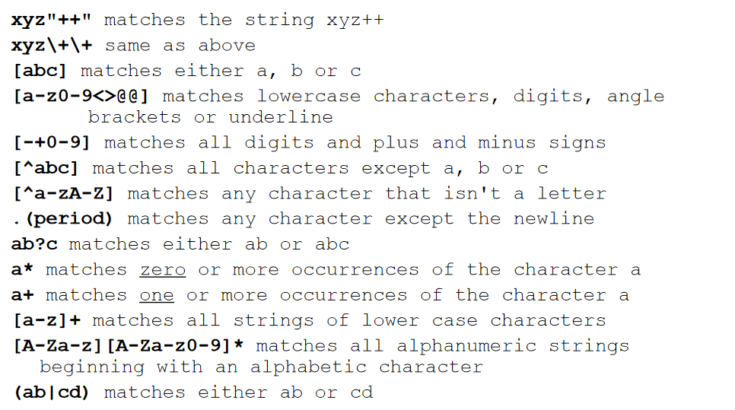
Lex Regex Examples

Slide 17
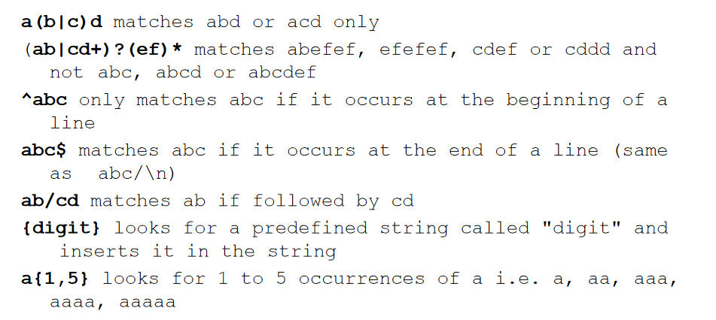
More Regex Examples

Slide 18
Even more Lex examples
Ignores spaces, tabs, and newlines.
%%
[ \t\n] ;
\\OR you can do this
“ “ |
\t |
\n ;

Slide 19
Even more Lex examples
You can print out what a pattern has matched using the variable yytext
%%
[a-z]+ printf(“%s”,yytext);
//OR you can do this
[a-z]+ ECHO;

Slide 20
Even more Lex examples
You can output the length of a matched string using yyleng.
You can also use yyless (not pictured here) if supported to wind characters back onto the input stream one at a time
Using both you can actively edit the input stream!
Lex will only store 100 characters though… so be aware.
%%
[a-zA-Z]+ {words++;
chars += yyleng;}

Slide 21
Ambiguous Rules
If two rules match, choose the longer match.
If they’re the same length, choose the one that was defined first.
In this case, integer is integer and not identifier because it comes first.
%%
integer //it’s an int!
[a-z]+ //it’s an identifier!

Slide 22
Last words on Lex
Lex will convert your code into C.
As Lex is a context sensitive analysis, pre-processor statements need to be dealt with differently than in C.
We can’t just use #defines
Two methods:
Use of Flags – when only a few rules change from one context to another – user defined
Use of start conditions – similar, but allows Lex to define the code required.

Slide 23
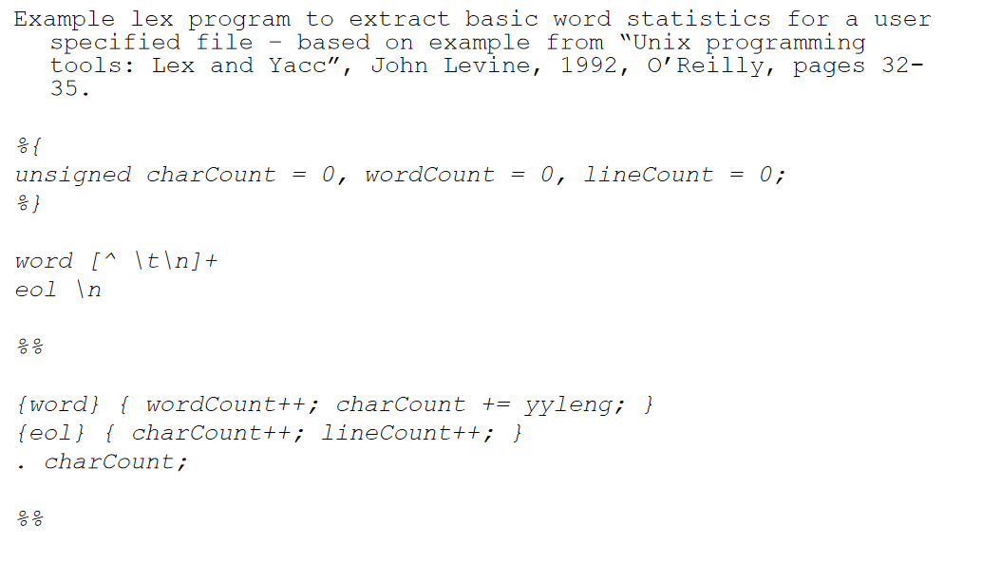
Example Lex Program

Slide 24
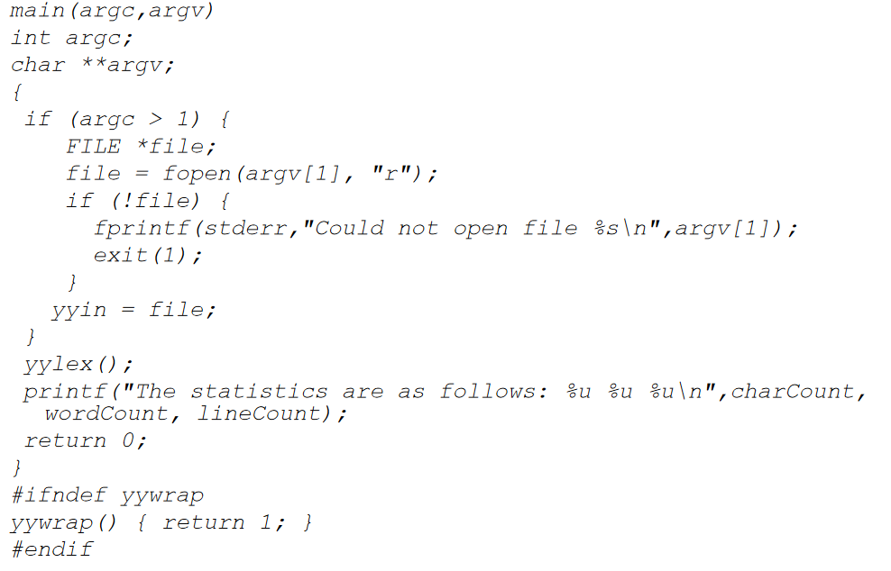
Example Lex Program Pt.2

Slide 25
YACC
The hard bit

Slide 26
Yacc
Yacc: Yet Another Compiler Compiler
Is a… compiler compiler.
Converts user defined grammar into a subroutine called yyparse() (it’s in C too) that handles the input process.
This calls a user-supplied routine, by default yylex() to return the next basic input item.
Lex and Yacc just plug into eachother, basically.

Slide 27
Yacc Grammar Overview
Specification is very general, LALR(1)
Look Ahead Left Recursive 1; one symbol look ahead
Yacc needs :
Specification of input process
Rules describing input structure
Code to invoke when rules are recognised
Low level routine to do the input
Yacc then generates a parser using lex to identify basic tokens from the input stream
Yacc attempts to recognise combinations of tokens that match the grammar it is programmed with.

Slide 28
Yacc Grammar
Actions are invoked when a match is found
date: month_name day ‘,’ year;
This matches “March 3, 1992”
Things recognised by Lex are Terminal Symbols
Things recognised by Yacc are Non-terminal Symbols
This makes it very easy to add new rules:
date: month ‘/’ day ‘/’ year;
Matches 3/3/1992

Slide 29
Yacc processing
Input errors are detected as early as possible with a left to right scan.
This early failure reduces the chance of reading and computing with bad data
Bad data is found quickly
Also, constructs difficult to handle in yacc tend to be hard for humans to understand
If you can’t write it in yacc easily, you probably can’t understand it as a human easily.
This can reveal poor design of your language!

Slide 30
Yacc format
File format:
{declarations} //optional %% {rules} //optional %% //optional {programs} //optional
Rule format:
A: BODY ;
Where A is a non-terminal symbol and BODY is a sequence of zero or more non-terminal symbols terminal symbols, and literals.
A literal is a single character in quotes: ‘a’ etc.

Slide 31
Escape Sequences
You can use C escape sequences as literals
‘\n’: newline
‘\r’: return
‘\’’: single quote
‘\t’: tab
‘\b’: backspace
‘\x01’-’\xFF’: hex defined character
Cannot use the null terminator.

Slide 32
Rules
These are typical Yacc rules.
You can do complex rules via multiple entries or by using logical or (“|”).
A rule may contain something, or be empty
Exactly one empty can exist in the entire rule set.
example: ;
A: B C D;
A: E F;
A: G;
//OR, you can do this:
A: B C D
| E F
| G
;

Slide 33
Tokens
Can define tokens in declaration section. These will match up with Lex definitions.
Can also define a start symbol in definitions.
%token name1 name2…
%start symbol

Slide 34
Actions
Actions can be defined as so:
A: ‘(‘ B ‘)’ {hello(1, “abc”);}
//OR
XXX: YYY ZZZ
{ printf(“a message\n”);
Flag = 25; }

Slide 35
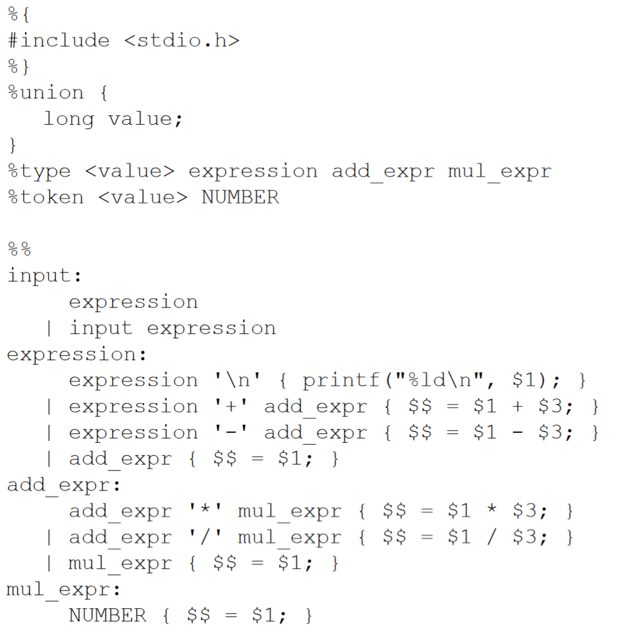
Example: A Calculator: Yacc

Slide 36
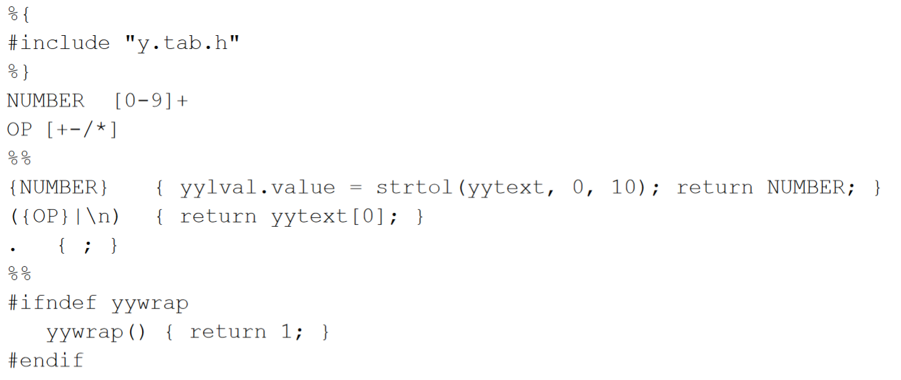
Example: A Calculator: Lex

Slide 37
Compile and run
To compile:
yacc –d calc.y
lex calc.l
gcc –o calc y.tab.c lex.yy.c -lfl
To run:
./mycalc
12+45
57
2 + 3
5
100 + -50
syntax error

Slide 38
But how does it work?
How does Yacc parse input?
It uses a stack, and a finite state machine with the following four actions.
Shift: used to push symbols onto the stack
Reduce: is used when the right hand side of the rule has been recognised, and can be replaced by the left hand side
Accept: Input has been parsed successfully
Error: A syntax error has been found.

Slide 39
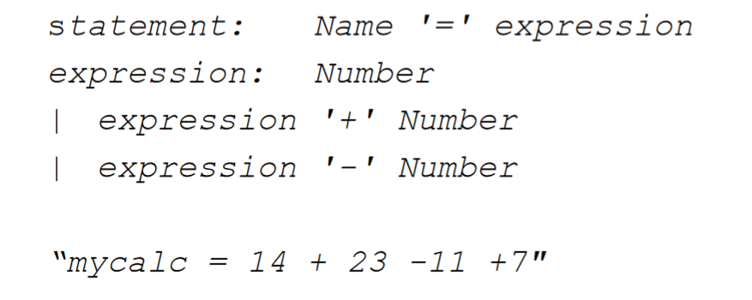
Recursive parsing example

Slide 40
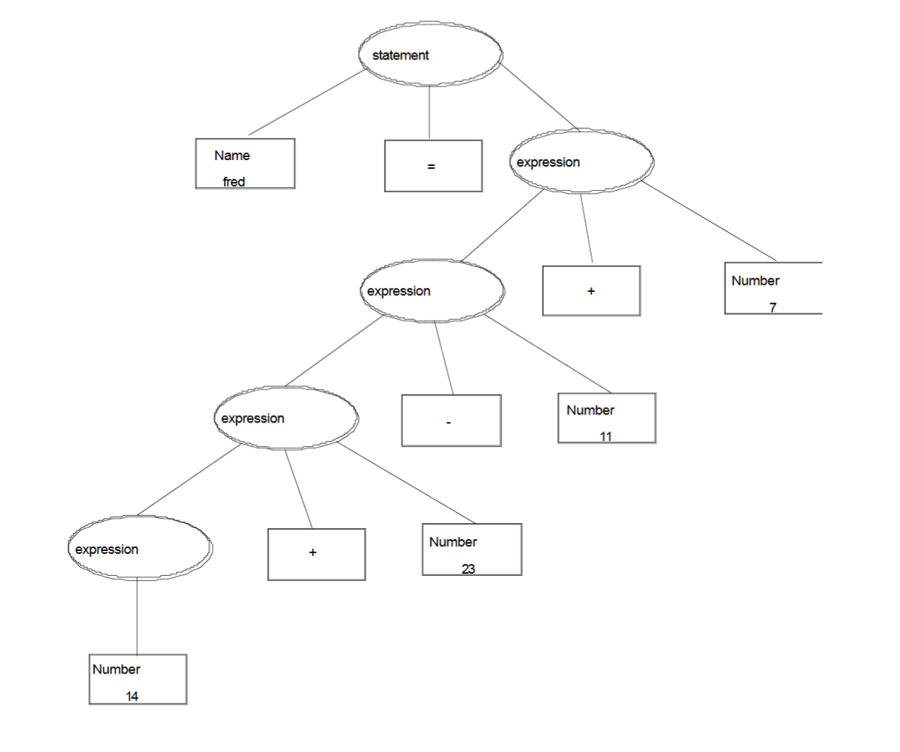
Recursive parsing example

Slide 41
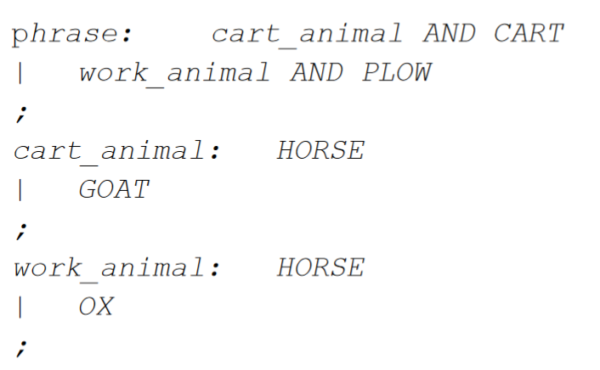
Problematic Grammar
Which non-terminal does HORSE belong to?
Needs two symbol lookahead.
HORSE AND CART vs HORSE AND PLOW, all Yacc can see is HORSE AND and HORSE AND.
This can be fixed by changing the phrase rule to
phrase: cart_animal CART | work_animal PLOW

Slide 42
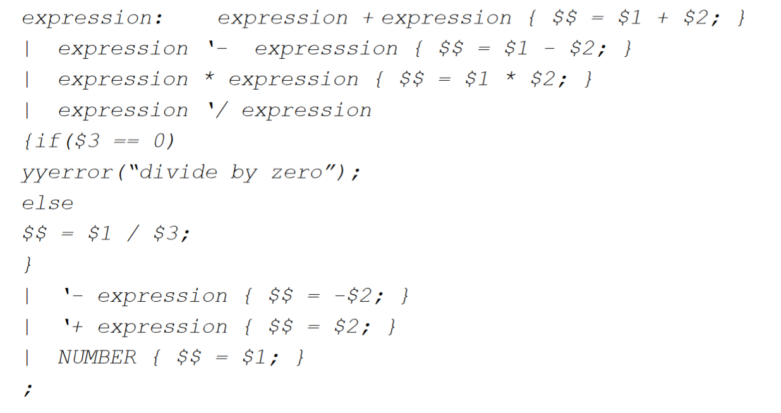
Ambiguity

Slide 43
Ambiguity
Parsing 2+3*4 gives (2+3)*4 or 2+(3*4)
Which one is which?
Yacc throws 16 shift/reduce errors and gives up.
This can be solved by precedence and associativity.
Left associativity: group left to right:
3-4+5 → (3-4)+5

Slide 44
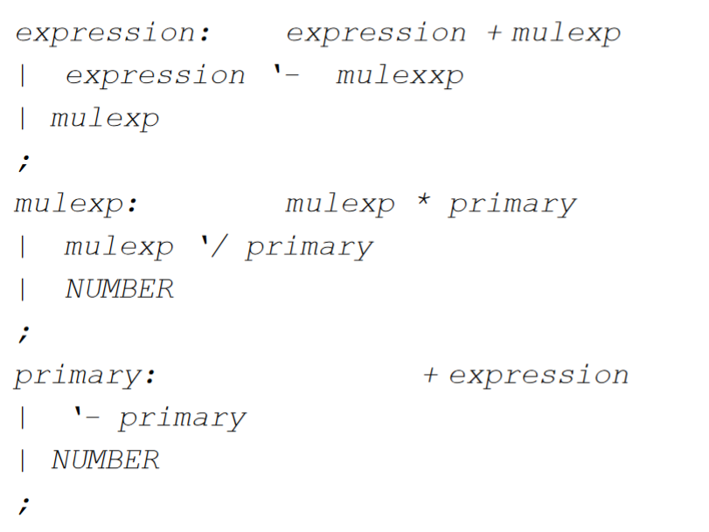
Implicit Precedence

Slide 45
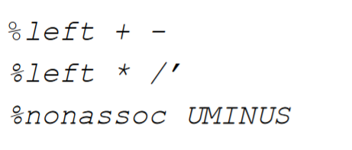
Explicit precedence

Slide 46
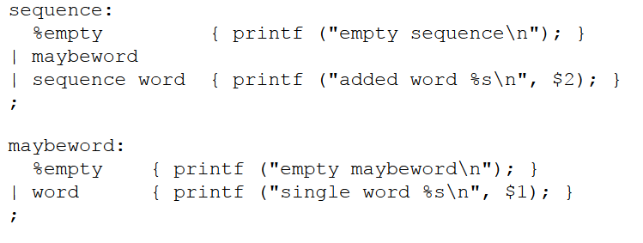
Reduce/Reduce
Reduce/reduce is a Bison error that you may run into if you have two ways of interpreting one thing.
Example over there →
Word can be sequence or maybeword.
Oh no
This usually solveable by ensuring only one empty!

